Slide 1
Overseas and Operational Suitability Screening
For NTC Point Loma

Slide 2
Step 1
Please read our process overview section in its entirety on our website https://sandiego.tricare.mil/Clinics/NBHC-NTC-San-Diego. This will cover common questions that we receive and will have all required forms available for download.
YOU MUST BE FULLY MEDICALLY READY. Your OSS package will not begin being processed until you are fully medically ready. Please review your own IMR to ensure you are ready for a timely submission. Common issues service members run into are delinquencies in PHA, Dental, Vaccinations, Pap smears, and Medical treatments not completed.
If you are LIMDU, you should not initiate your OSS until you are fit for full duty. If your LIMDU timeline interferes with execution of your orders, you should work with your admin and initiate an ACC code change from 100 (worldwide deployable) to whatever code fits your limitations and have your LIMDU coordinator and admin submit to PERS for orders that fit your requirements.
Our points of contact are also in this section. All questions can be asked to our distro dha.san-diego.San-Diego-NMC.mbx.oss-help-desk@health.mil. Email is our primary method for communications.
If you message into our distro and do not receive a response in 72 business hours, please re-send the email double checking the correct distro was addressed.
If you are having any issues contacting us, our front desk number +1 (619) 524-6053. We cover 700 commands and multiple states so please have patience with our phone lines as they are usually inundated with calls. We may not have staff available to answer these phone calls or there may be calls ahead of yours, our staff tries their best to help everyone and answer what they can. We highly encourage walk-ins and email correspondence.
We accept all walk-ins into our clinic 0730-1600 Located at 2051 Cushing Road San Diego, CA 92016. The clinic is located 1st floor back left corner of the courtyard.
If you work in a SCIF or any place with device restrictions or limited service, please let our staff know so we can do our best to accommodate when booking your APPT for the provider phone call. If you require an expedited appointment, please explain to our staff the situation when you submit and we will do what we can with getting you an emergency slot.

Slide 3
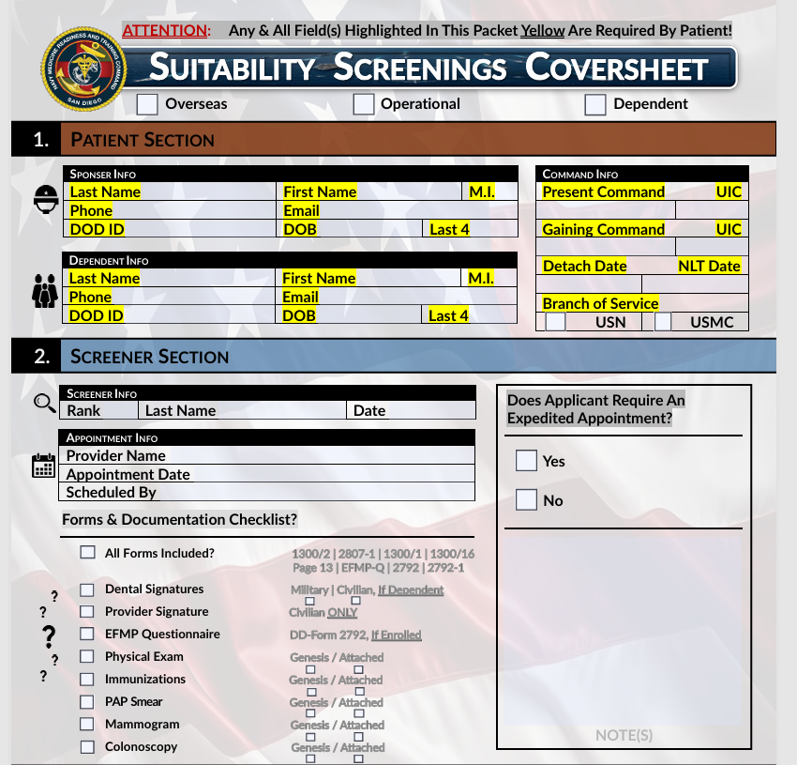
Step 2- Coversheet
Top Page, Sponsor Info, Dependent Info, Command Info: Mark the box at the top of the page if your package is for Overseas or Operational and if it is a dependent package.
Fill all highlighted areas.
1. Dependent info only needs to be filled out for Dependent packages.
2. There is a Form Checklist in the screener section you can utilize to ensure you have everything necessary.
3. Please arrange your package in the following order.
Coversheet, 2807-1, 1300/1, 1300/2, 1300/16 (Overseas)
or Page 13 (Operational), EFMP Questionnaire or 2792 if EFMP,
supporting documentation such as dependent encounter
notes, Dependents IEP, LIMDU letters etc, lastly your orders
or sponsors orders, LOI, message traffic confirming next
duty station. If your package is disorganized, you will be asked to arrange the submission into an orderly package.
4. The back of the coversheet also has useful information for common questions such as…
Where does dental sign?
Where do civilian providers sign?
What supporting documents need to be provided if dependents are seen by non-military providers?
D
Add Orders and any medical supporting documentation. LIMDU Letters/ Dependent civilian medical notes etc.

Slide 4
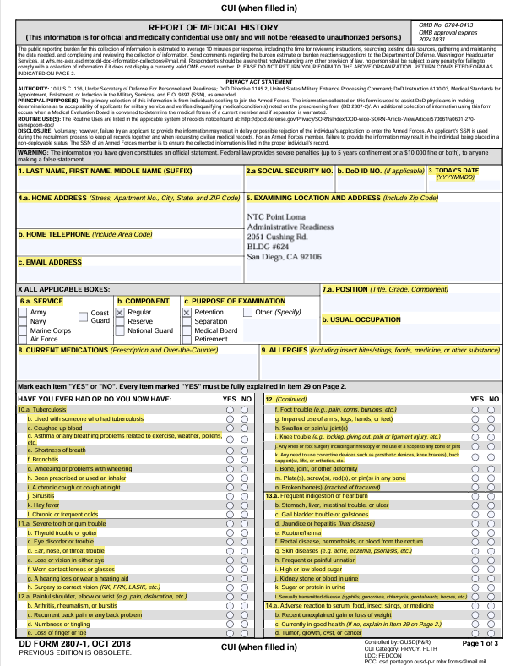
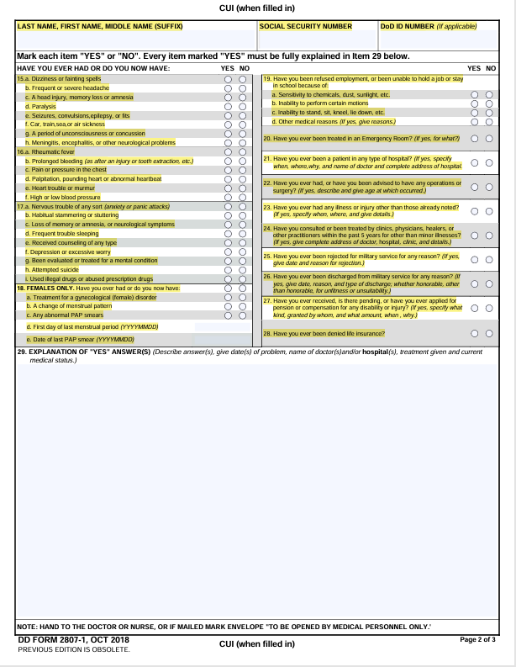
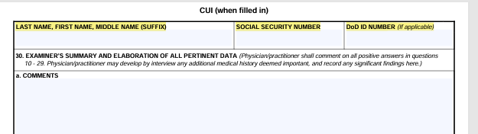
Step 3- DD 2807
The DD form 2807-1 has 3 pages. Please fill out all highlighted areas on all 3 pages including DODID and full social on every page.
Bubble in all answers. Please take note of 14.c. asking if you are currently in good health
For any questions answered yes, please explain them in box 29 on page 2. EX.16a. Had Rheumatic Fever when deployed to Africa.
Leave the examiner section box 30 blank. Only NTC providers will fill out this page for a screening package.
Bubble in Yes or No
All yes answers.
EX. 11.f. Prescribed Glasses

Slide 5
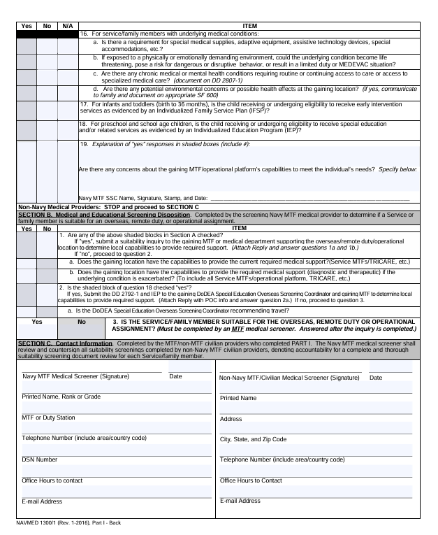
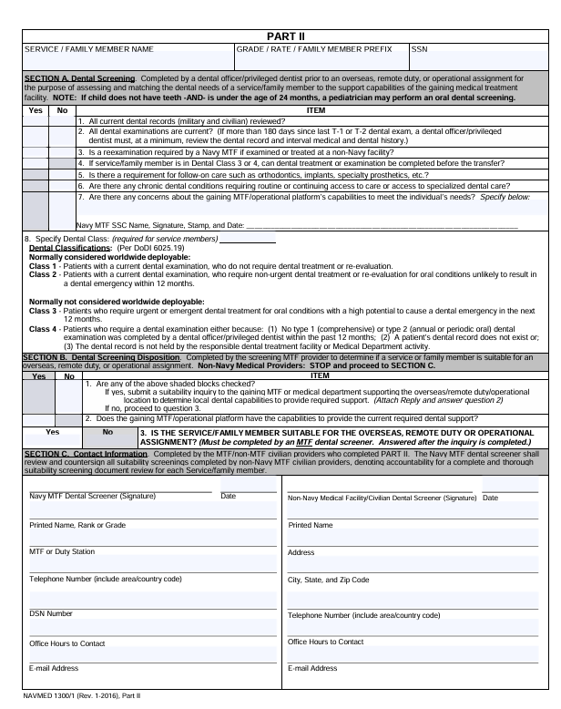
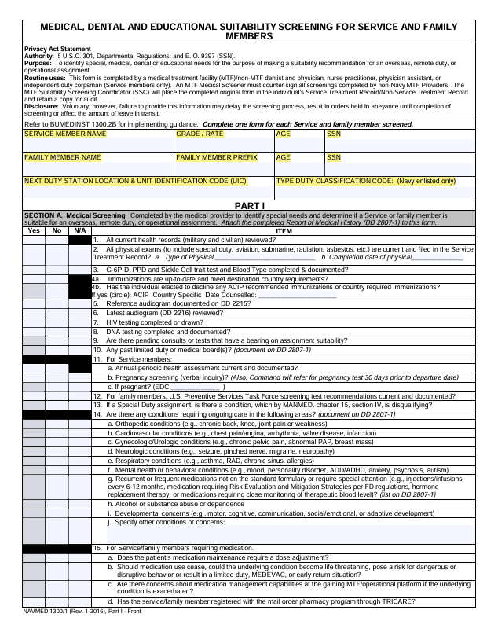
Step 4- NAVMED 1300/1-
This form is comprised of three pages. You only need to fill out your demographics on page 1 & 3 and get Dental signature on Page 3. Dental can sign if you are class 3 or 4, they would just annotate in block 7 and mark boxes accordingly.
Please fill out all highlighted areas. Type duty classifications are as follows.
Code 1: Shore Duty (Duty performed in the U.S. land-based activities)
Code 2: Sea Duty (Duty performed in vessels or deployable fleet units)
Code 3: Overseas Remote Land-based Sea Duty
Code 4: Overseas Sea Duty
Code 6: Overseas Shore Duty
Dependent Medical Provider-Cosign spot.
Only for Dependents seen by Non Military Providers.
Military Dental Provider signs on the left. Both areas must be signed for Dependents. Get your civilian dentist to sign on the right and provide you with your dental record. Please bring your dental records to your sponsors Dental MTF for the left signature after the civilian dentist sees you, if you are a Dependent.
Non-Military signs on the right.
Demographics on 3rd page

Slide 6
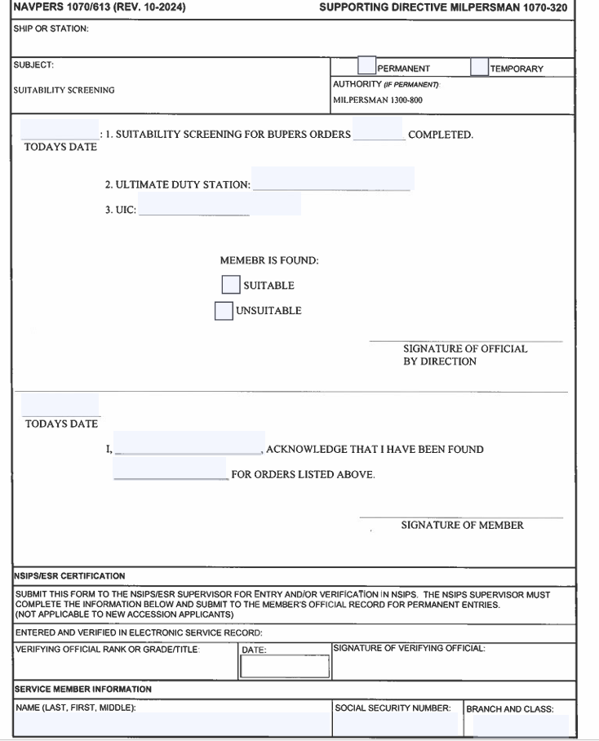
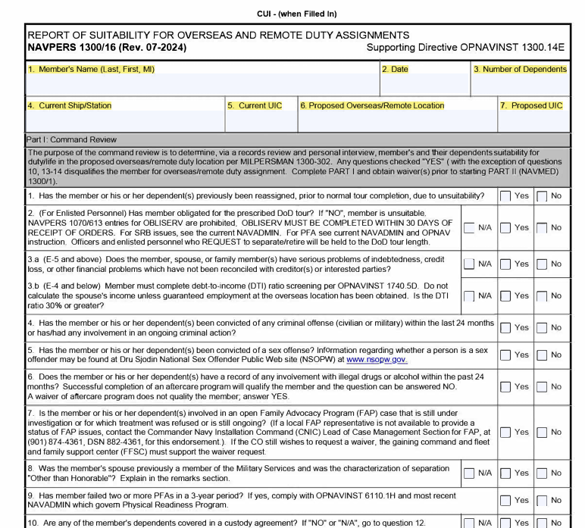
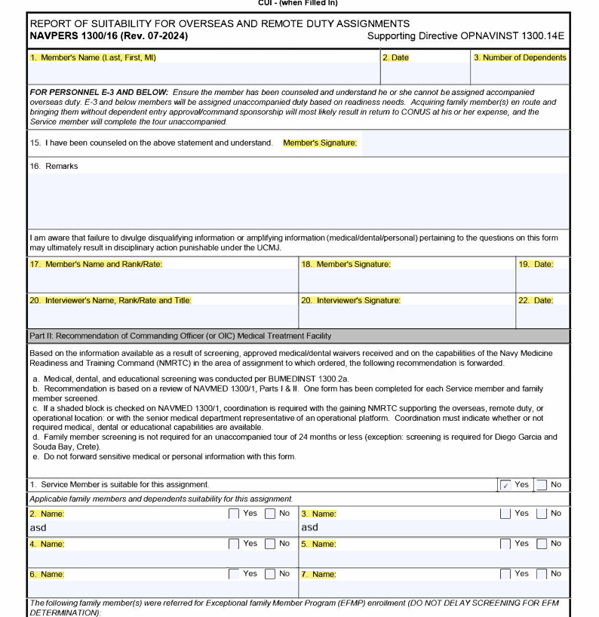
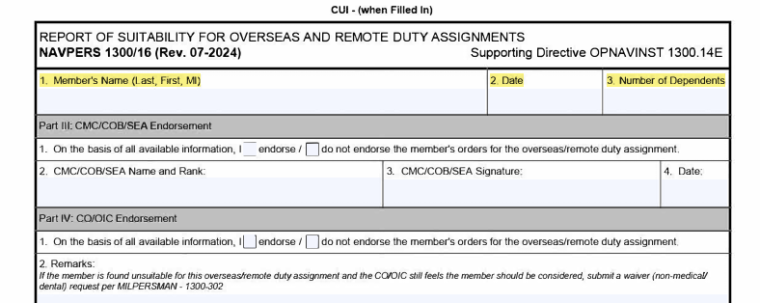
Step 5- 1300/16 (Overseas) or Page 13 (Operational)
The 1300/16 is for Overseas orders and the Page 13 is for Operational orders. Fill out the highlighted areas with your demographics for the 1300/16 and the square red boxes in the bottom right example on this slide. Once you receive your provider phone call, one of these pages will be processed by our team and your package will be ready for pick up in 72 hours. If you are an “inquiry”, our team will reach out to the email provided in the package with further instructions. Inquiries are typically sent out within 48 hours.
If you are told you are an inquiry by the provider and don’t receive an email within 48 hours of your appointment about the process, please email into our inquiry distro dha.san-diego.San-Diego-NMC.mbx.ntc-ssc@health.mil and request an update.
Fill out the below red boxes on your form
Please fill out the highlighted portions for the 1300/16

Slide 7
EFMP Questionnaire, 2792 and 2792-1
The EFMP questionnaire is our offices way of screening if your dependent has requirements that may need EFMP enrollment. Please be honest in this questionnaire as we need to initiate this as soon as possible. If you mark no on everything asked and our provider screens the package than finds EFMP should have be initiated, your package will be delayed as these requirements will then need to be met for the inquiry to be sent for your dependent .
The 2792-1 must be filled out for all dependents for the following age group birth- 21 years old.
Birth to age 3. The form must be completed for children in this age group, specifically if they have or require an Individualized Family Service Plan (IFSP).
If a child is under 5 years old, not enrolled in school or an early intervention program, and has no identified needs, parents/guardians only need to complete and sign Page 2 of the form.
For children ages 3 to 5, the form should be completed at the school they would normally attend for kindergarten.
3 to 21. Required for dependents in this age group who have or require an Individualized Education Program (IEP)
High school graduates, students who have passed the GED, and college students are not required to complete the DD Form 2792-1.
Please include in the package a current IFSP, IEP if child is enrolled.
Please take note on the 2792-1; 1. REQUEST- will be request for Government sponsored travel and for all questions asked NO or N/A is a plausible answer. Please do not leave questions blank or expect our staff to fill out these forms for your dependents.
If dependent is EFMP please attach the 2792 to the package with the 2792-1 if needed.

Slide 8
Dependent additional information
If a dependent is seen by a civilian provider, we require a physical within 1 year with a printout of the visit that shows a full review of systems. We do not accept the after visit summary as this does not have the information our providers require.
If a dependent is seen by a civilian provider, we require their vaccine record. If you cannot obtain a vaccine record, we can order a titers test, which is a blood draw to see what immunities you have and update your medical record with these results.
If a dependent is seen by a civilian provider for their PAP exam, mammogram, or colonoscopy we need the notes that show the results. Summary of visits that do not display the test and results will not be accepted as these do not give our providers the information they are looking to review.
Medical notes required are usually the most recent physical or test within the last couple years. If a submission has a full dependents medical record instead of the requested information, we will request the member or the dependent locate the requested information and submit that to us. If you need assistance finding the information our staff can help guide you to the information.
All dependent “requirements” are recommendations by our medical team but refusal of fulfilling these recommendations do automatically flag your dependents as possible inquiries where we will need to get gaining MEDCOG approval for transfer. These inquiries may be approved or denied. If denied, this can result in loss of orders or execution of orders as unaccompanied.
Unvaccinated dependents and/or no vaccine records will automatically cause your dependents to be inquires to their gaining MEDCOG.
Dependents must be enrolled in Genesis and have DODID numbers. The Genesis number for our area is 619-532-8366. If they are not enrolled, please facilitate this by calling the number provided before submission.

Slide 9
Orders, Letter of Intent (LOI), Notifications, Cantrac/ school requirements
Please initiate your OSS within 3 days of receiving orders for Navy personnel and 10 days for Marine Corp.
Our staff will try our best to honor completion of the package within 30 days of submission and 60 days for dependents as required by instruction. This timer does not start until we have accepted your package and you are fully medically ready.
It is highly recommended to submit as soon as possible so your family has enough time to PCS stress free, as inquiries do take a considerable amount of time depending on what they are for and where they are going.
We accept official notifications of orders such as emails/messages with detailers or monitors or memo, just explain to our staff what you are submitting. Our staff needs to know why are you submitting the package, where your current command is, and what your gaining command will be.
If submitting for a special program/C-school, please have the cantrac or instruction attached that show the suitability screening as an attachment.
Suitability Screenings are typically for PCS orders. We do not facilitate suitability screenings for IA orders or temporary assignment unless a LOI is provided or it is specifically required on the IA orders.

Slide 10
Last Notes
NTC Point Loma OSS tries our best to help over 700 UIC’s and our neighboring states. Please be patient with our staff as we are trying our best to help everyone meet their timelines and do understand the impact suitability screenings can have on service members and their families. We prioritize packages based on multiple factors such as availability, timelines, medical concerns, orders etc.
If you have any issues or request to be expedited, please let our staff know and we will assist. If you messaged us or have not received a reply within 72 business hours, please continue to send another email requesting a follow up. Additionally, you can stop by our office during our hours of operation.

